Slide 1

Experiencing M I S
Ninth Edition
Chapter Extension 8
Using Excel and Access Together
Copyright © 2021, 2019, 2017 Pearson Education, Inc. All Rights Reserved
Notes:
If this PowerPoint presentation contains mathematical equations, you may need to check that your computer has the following installed:
1) MathType Plugin
2) Math Player (free versions available)
3) NVDA Reader (free versions available)

Slide 2
Study Questions
CE 8-1 Why use Excel and Access together?
CE 8-2 What is import/export?
CE 8-3 How can you create charts with Excel?
CE 8-4 How can you create group totals in Access?
CE 8-5 How can you use Excel to graph Access data?
CE 8-6 How can you use Access to report Excel data?
CE 8-7 How can you combine Excel and Access to analyze data?
Notes:
This chapter explains how to use Access and Excel together to analyze data in ways neither can do alone. You will learn how to create graphs in Excel and group totals in Access queries.

Slide 3
Using Access and Excel Together
CE 8-1 Why use Excel and Access together?
Access
D B M S for keeping track of things and creating reports
Excel
Use for creating sophisticated graphs and analyzing data
Why use together?
To eliminate re-keying data, reduce labor, and errors

Slide 4
Import/Export
CE 8-2 What is import/export?
Process of transferring data from one system to another
Creates temporary connection to source data
Connection closes after data transferred
Develop procedures (manual or automated) to ensure data refreshed on a timely basis

Slide 5
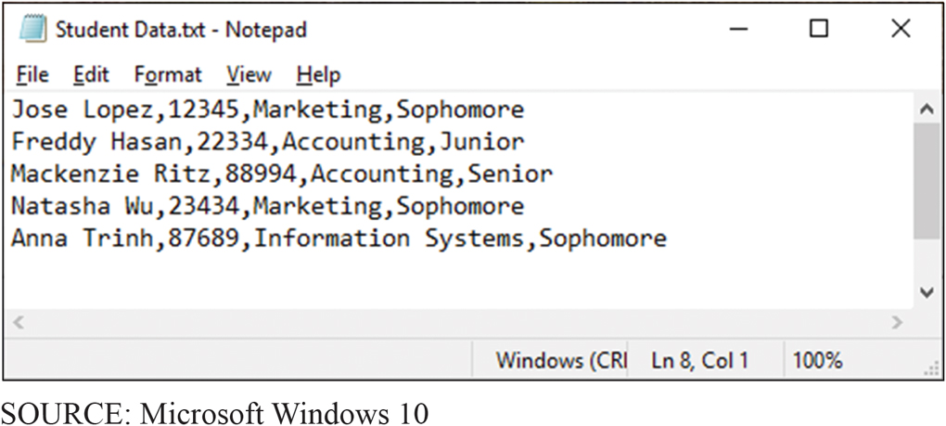
Example of Data Exported from University Enrollment System
CE 8-2 What is import/export?
Figure C E 8-1 Example of Data Exported from University Enrollment System
Notes:
Common way for systems to exchange data is to create files of text.
Tab used to create a tab-delimited text file.

Slide 6
Creating a Text File in Access
CE 8-2 What is import/export?
Open a database, click on External Data tab
Select file that contains data to import
Click Import and O K
Multiple-panel wizard opens
Specify data file is delimited
Name fields and data type

Slide 7
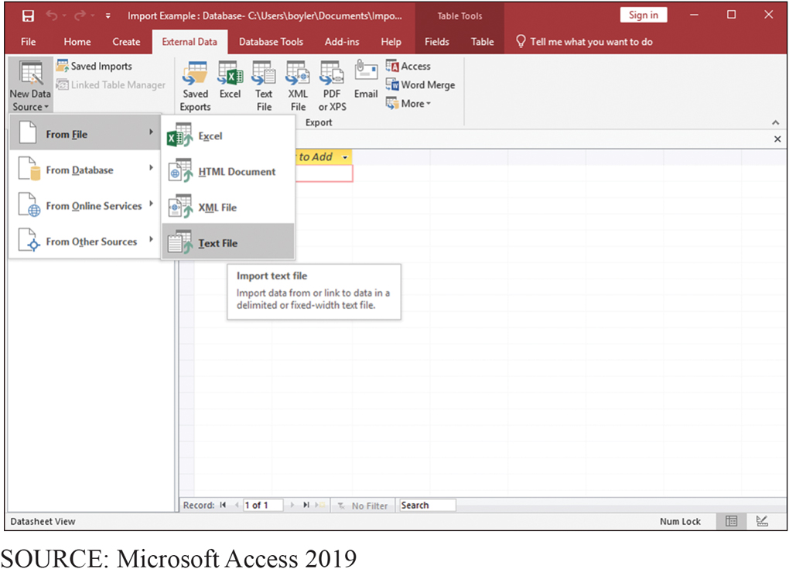
External Data Menu
CE 8-2 What is import/export?
Figure C E 8-2 External Data Menu Choice
Notes:
Create (or open a database) and click EXTERNAL DATA tab.

Slide 8
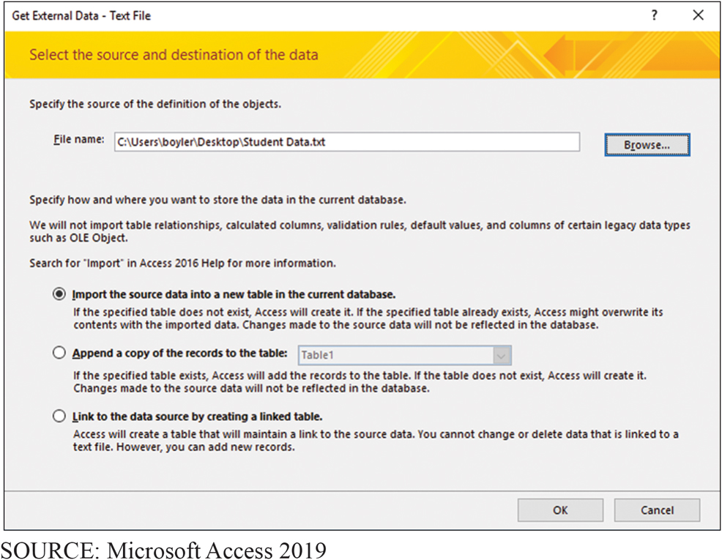
Source File and Destination
CE 8-2 What is import/export?
Figure C E 8-3 Specifying the Source File and Destination

Slide 9
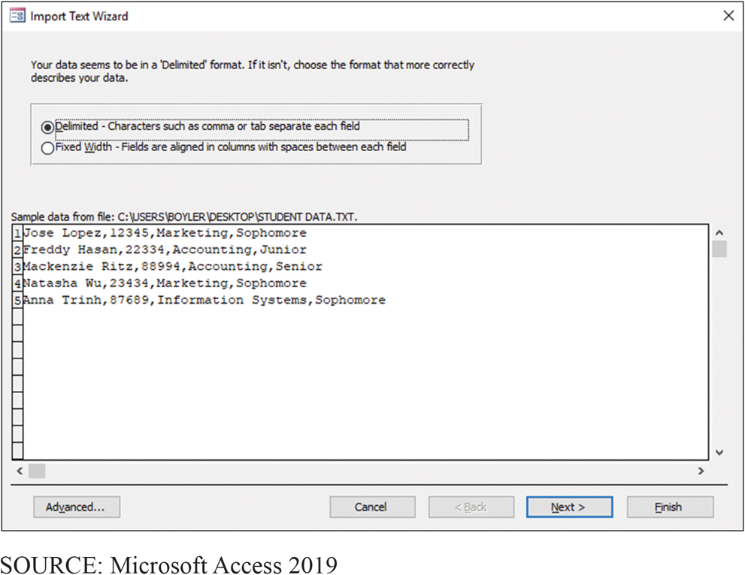
Specifying a Delimited File
CE 8-2 What is import/export?
Figure C E 8-4a Importing Text Data into Access: Specifying a Delimited File
Notes:
The specified file is delimited.

Slide 10
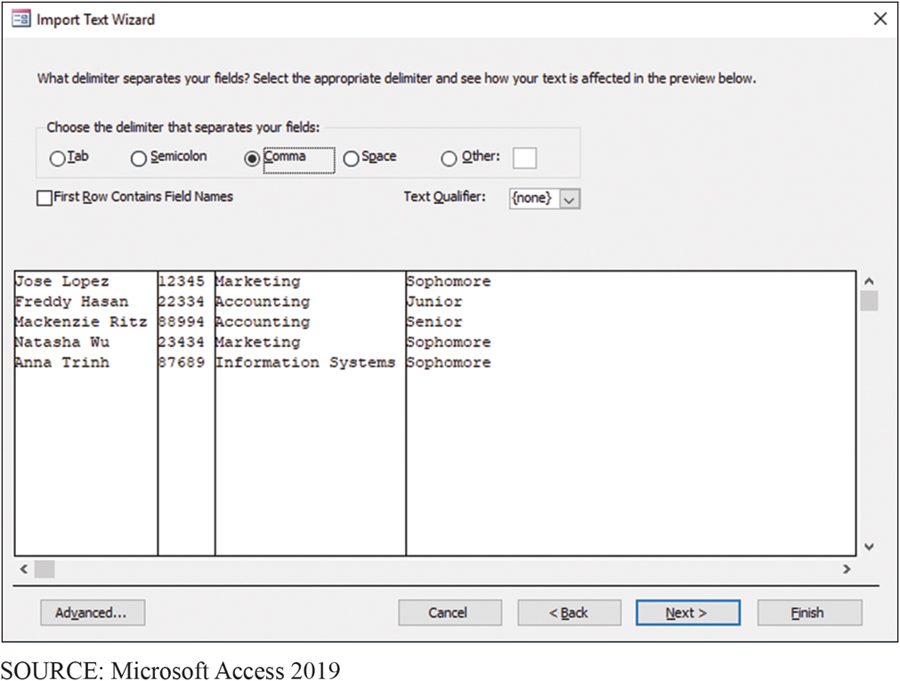
Specifying a Comma-Delimited File
CE 8-2 What is import/export?
Figure C E 8-4b Importing Text Data into Access: Specifying a Comma-Delimited File

Slide 11
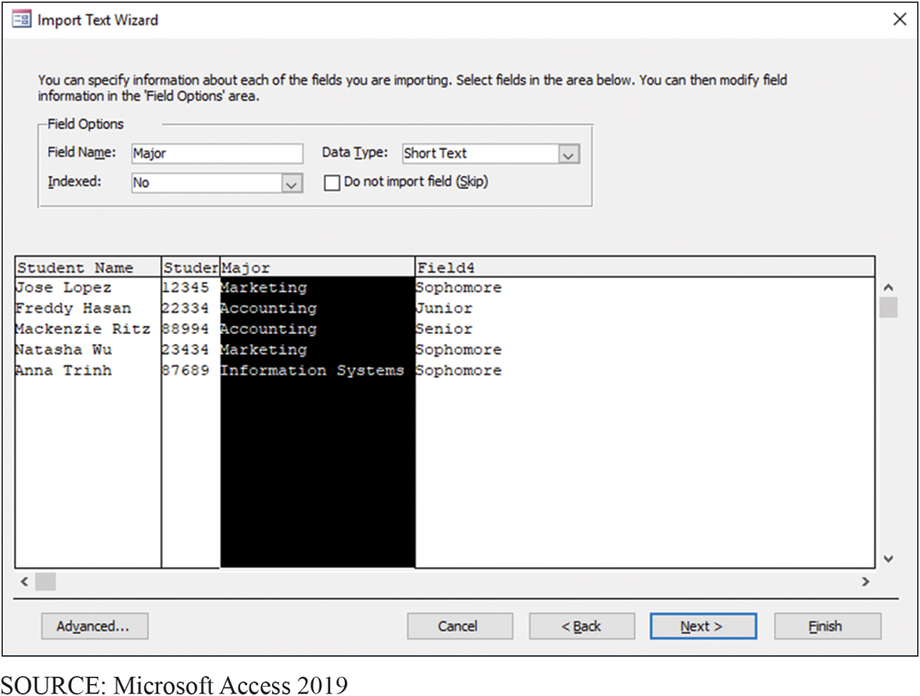
Naming and Describing Columns
CE 8-2 What is import/export?
Figure C E 8-4c Importing Text Data into Access: Naming and Describing Columns During Import

Slide 12
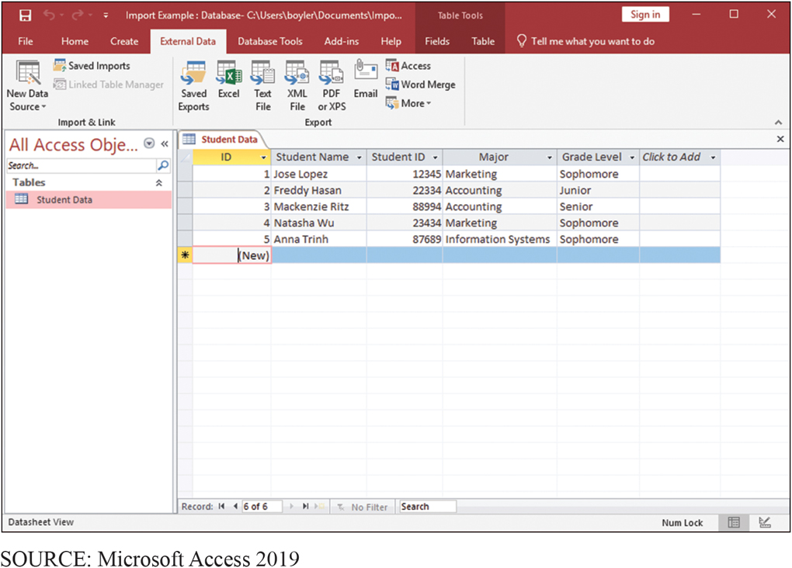
Data after Import
CE 8-2 What is import/export?
Figure C E 8-5 Data After Import
Notes:
Almost identical process to import data into Excel.

Slide 13
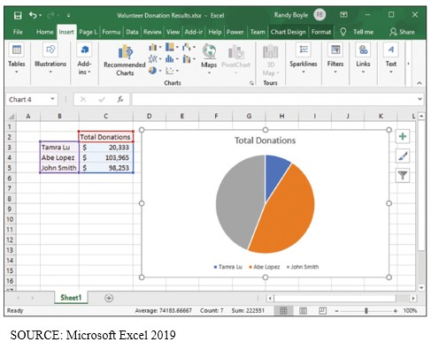
Pie Chart
CE 8-3 How can you create charts with Excel?
Figure C E 8-6 Pie Chart
Notes:
The following slides show the steps to create this pie chart.

Slide 14
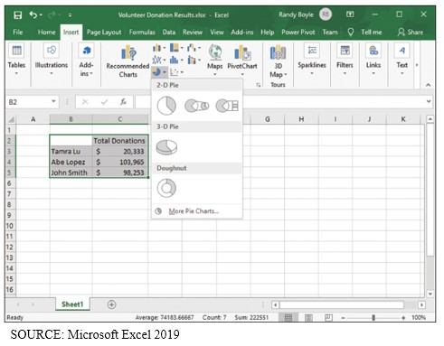
Creating a Pie Chart
CE 8-3 How can you create charts with Excel?
Figure C E 8-7 Creating the Pie Chart
Notes:
Click Insert tab in ribbon, and in Charts section of that ribbon select Pie icon.

Slide 15
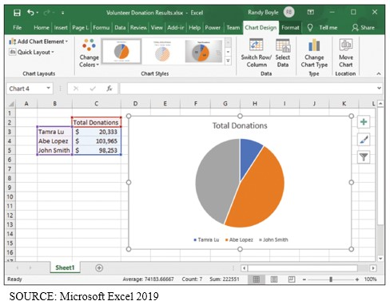
Selecting the Chart Tools
CE 8-3 How can you create charts with Excel?
Figure C E 8-8 Selecting the Chart Tools
Notes:
Pie chart tools are displayed by selecting the graph, then clicking the Chart Design tab.

Slide 16
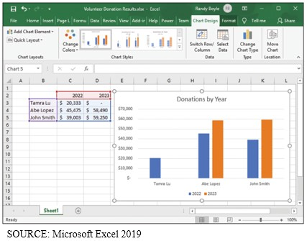
Sample Column Chart
CE 8-3 How can you create charts with Excel?
Figure C E 8-9 Sample Column Chart

Slide 17
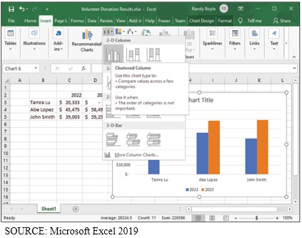
Creating the Column Chart
CE 8-3 How can you create charts with Excel?
Figure C E 8-10 Creating the Column Chart
Notes:
Click on Insert, then Column icon to get the drop-down column chart options.

Slide 18
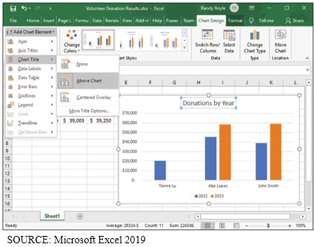
Creating the Chart Title
CE 8-4 How can you create group totals in Access?
Figure C E 8-11 Creating the Chart Title
Notes:
To insert a title, click Column chart, select Chart Tools, click Layout tab, click Chart Title, and select Centered Overlay Title.
Add Chart Element list has numerous other options.

Slide 19

How Can You Create Group Totals in Access?
CE 8-4 How can you create group totals in Access?
Notes:
Open the Volunteer database, click the Create tab, click Query Design, then, as shown in next slide, select the WORK table for the query. After adding that table, click Close.

Slide 20
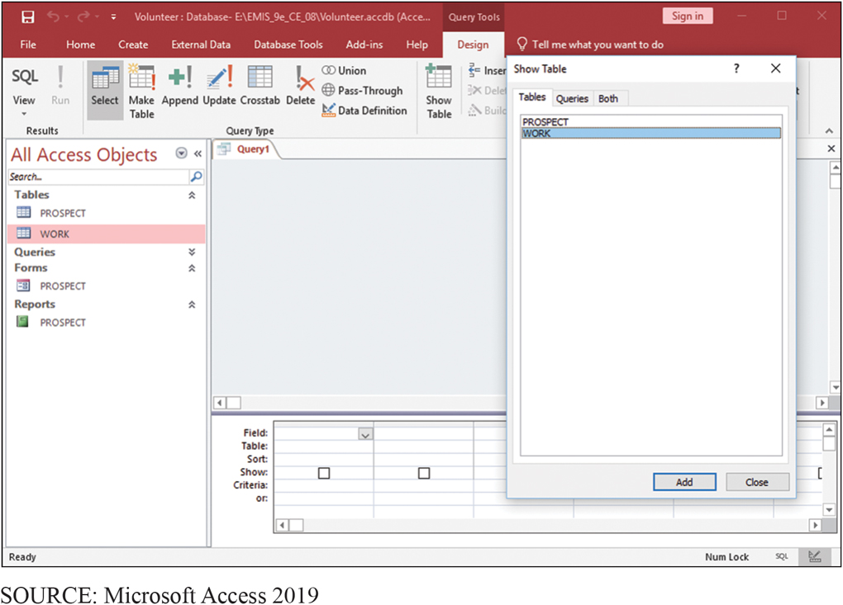
Selecting the WORK Table
CE 8-4 How can you create group totals in Access?
Figure C E 8-12 Selecting the WORK Table for the Query
Notes:
To open Volunteer database, click Create tab, click Query Design, then, select the WORK table for query. After adding table, click Close.

Slide 21
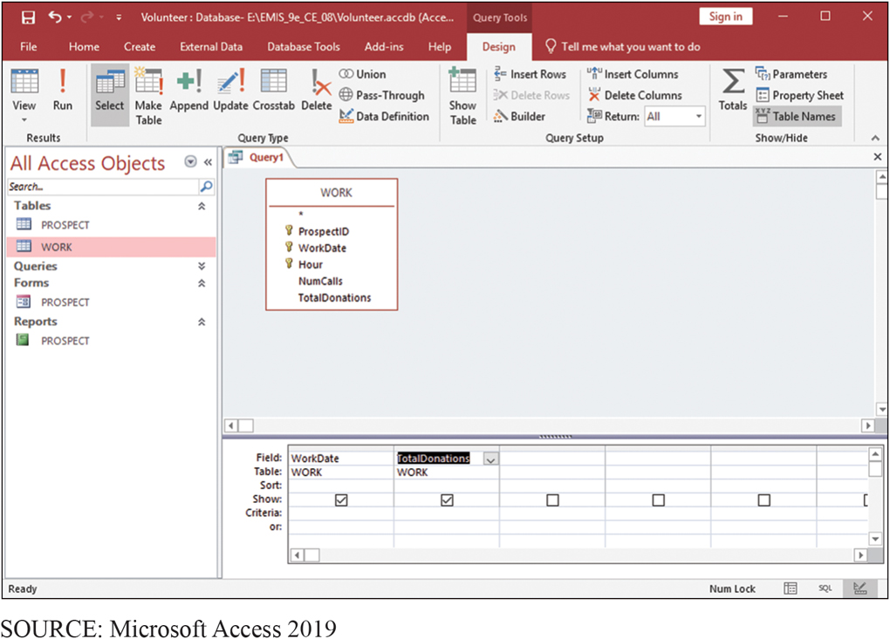
Adding Data and TotalDonations to the Query
CE 8-4 How can you create group totals in Access?
Figure C E 8-13 Adding Data and TotalDonations to the Query
Notes:
To add WorkDate and TotalDonations to query output, click check boxes for WorkDate and TotalDonations in WORK table diagram.

Slide 22
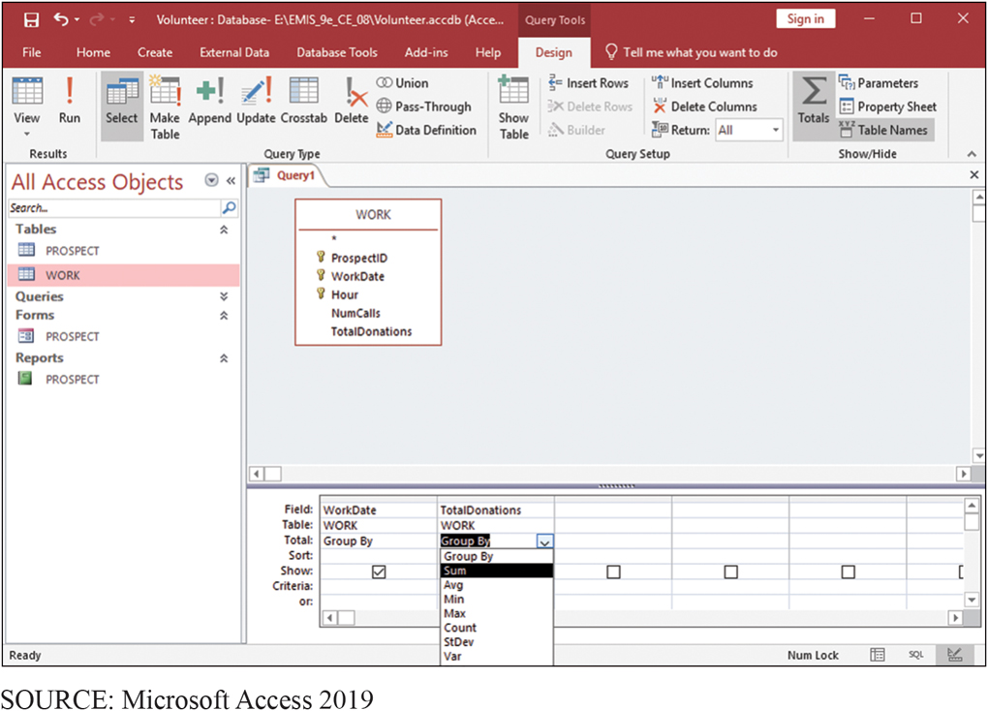
Sum in the Total Row for TotalDonations
CE 8-4 How can you create group totals in Access?
Figure C E 8-14 Selecting Sum in the Total Row for TotalDonations
Notes:
To group WORK rows according to date, click the Totals button in the Show/Hide section of the Design tab. This will add a row labeled "Total" to query contents table.
To group the rows by date, select the keyword Group By in the Total row under WorkDate. To sum TotalDonations for each group, select the keyword Sum under the TotalDonations column, in that same Total row.

Slide 23
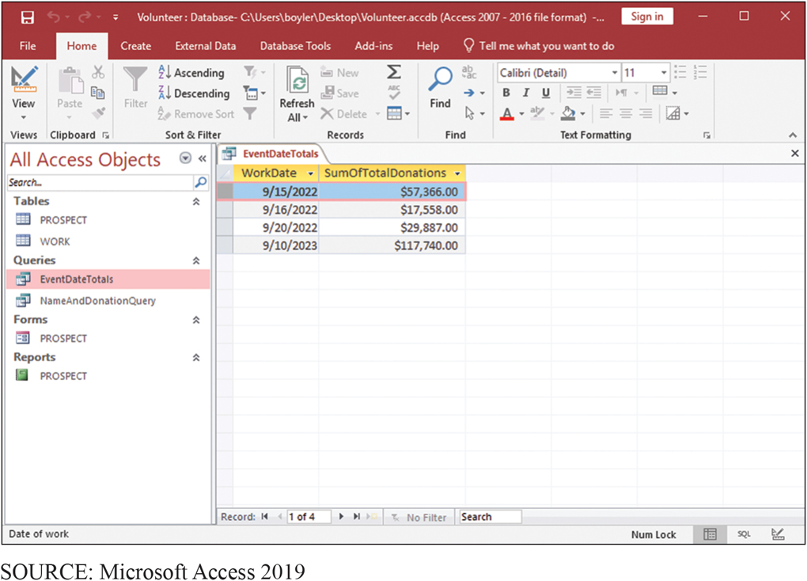
Results of Query with Group by Date
CE 8-4 How can you create group totals in Access?
Figure C E 8-15 Results of Query with Group by Date

Slide 24
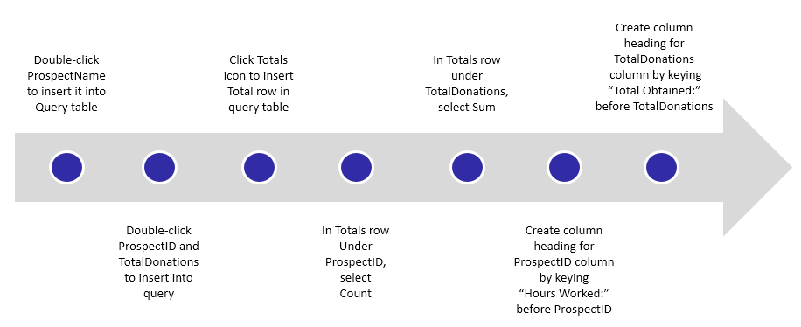
Steps for Creating a Query to Compute Total Hours and Donations
CE 8-4 How can you create group totals in Access?

Slide 25
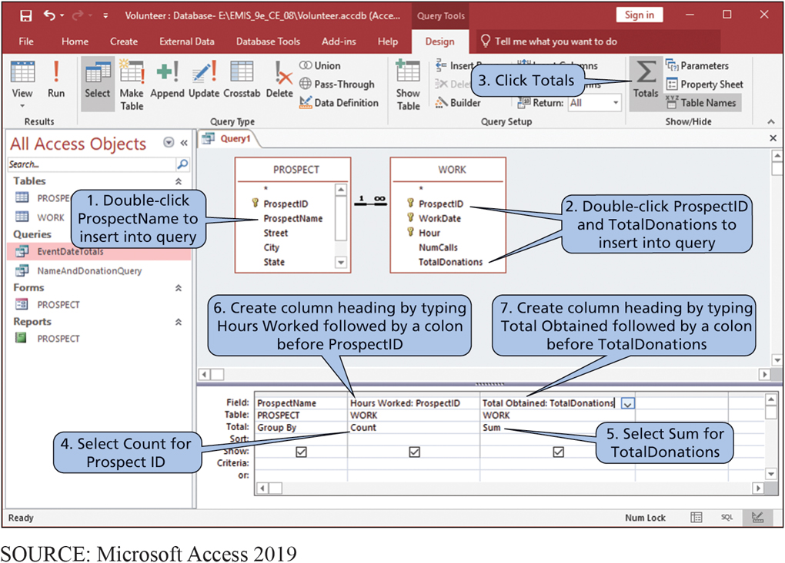
Query to Compute Total Hours and Donations for Each Prospect
CE 8-4 How can you create group totals in Access?
Figure C E 8-16 Process for Creating a Query to Compute Total Hours and Donations for Each Prospect

Slide 26
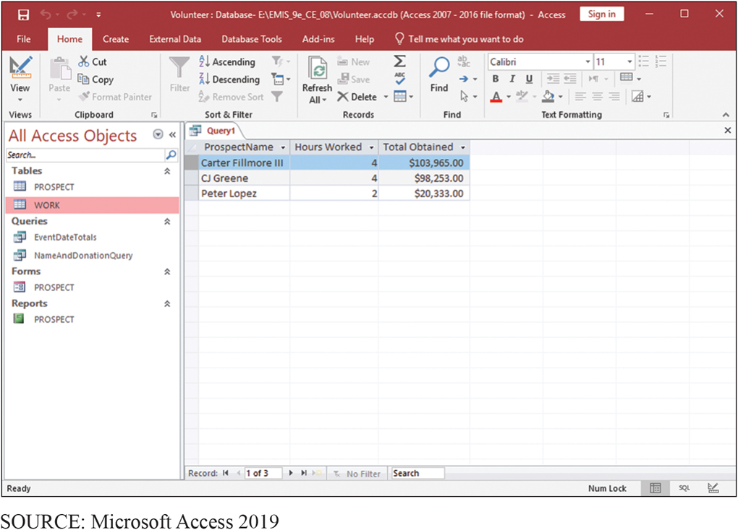
Results of Query
CE 8-4 How can you create group totals in Access?
Figure C E 8-17 Results of the Query in Figure C E 8-16

Slide 27
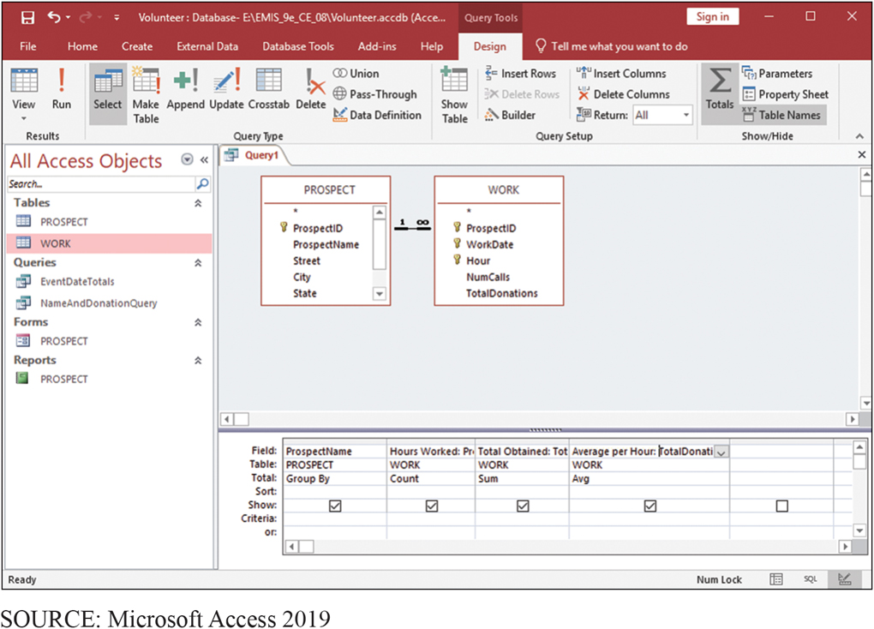
Adding Average Donations Per Hour
CE 8-4 How can you create group totals in Access?
Figure C E 8-18 Adding Average Donations per Hour

Slide 28
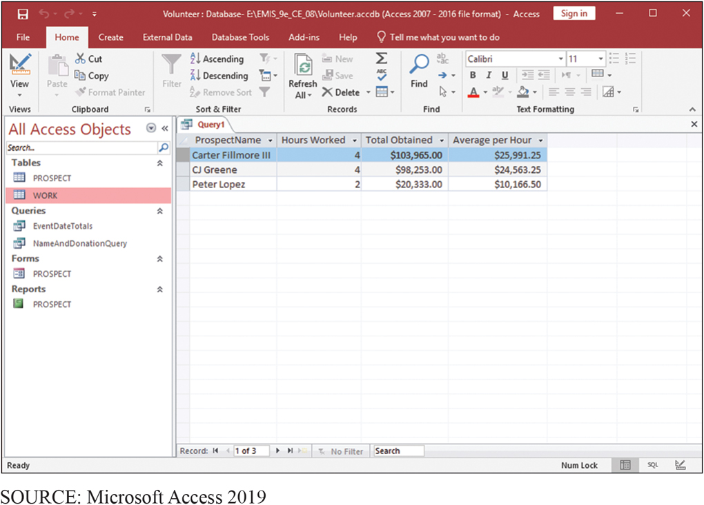
Results of Query in Figure C E 8-18
CE 8-4 How can you create group totals in Access?
Figure C E 8-19 Results of the Query in Figure C E 8-18

Slide 29
Using Excel to Graph Access Data
CE 8-5 How can you use Excel to graph Access data?
Import Access query into Excel and use Excel’s graphing capability to display results
To import data into Excel:
Click Data tab
Click Get Data section, select From Database, then From Microsoft Access Database
Select Volunteer database

Slide 30
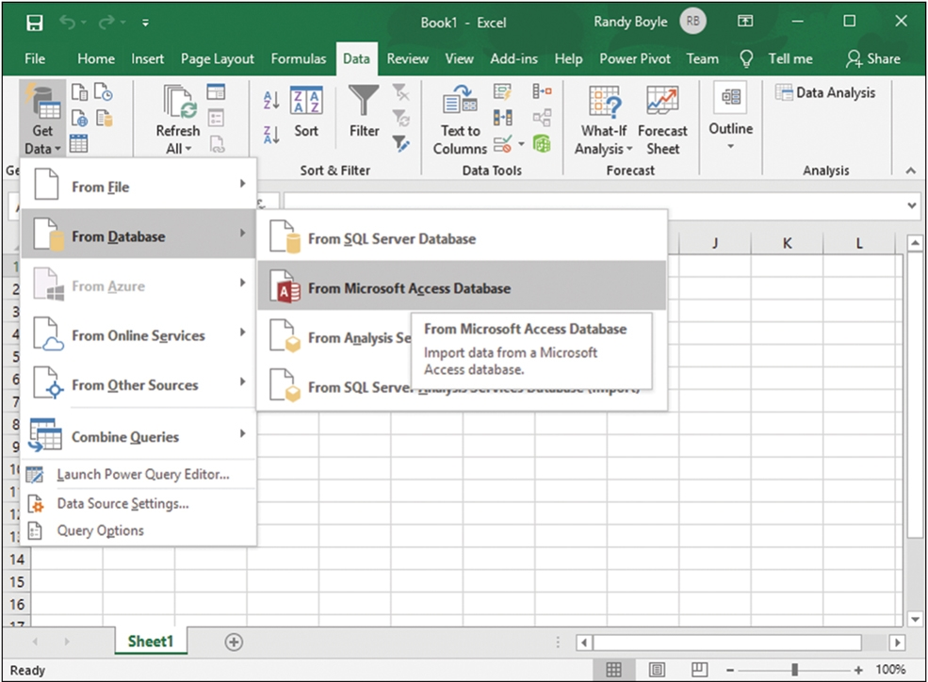
Menu to Import Data from Access into Excel
CE 8-5 How can you use Excel to graph Access data?
Figure C E 8-20 Menu to Import Data from Access into Excel
SOURCE: Microsoft Excel 2019
Notes:
Click Data tab
Click Get Data section, select From Database, then From Microsoft Access Database
Select Volunteer database (not shown)

Slide 31
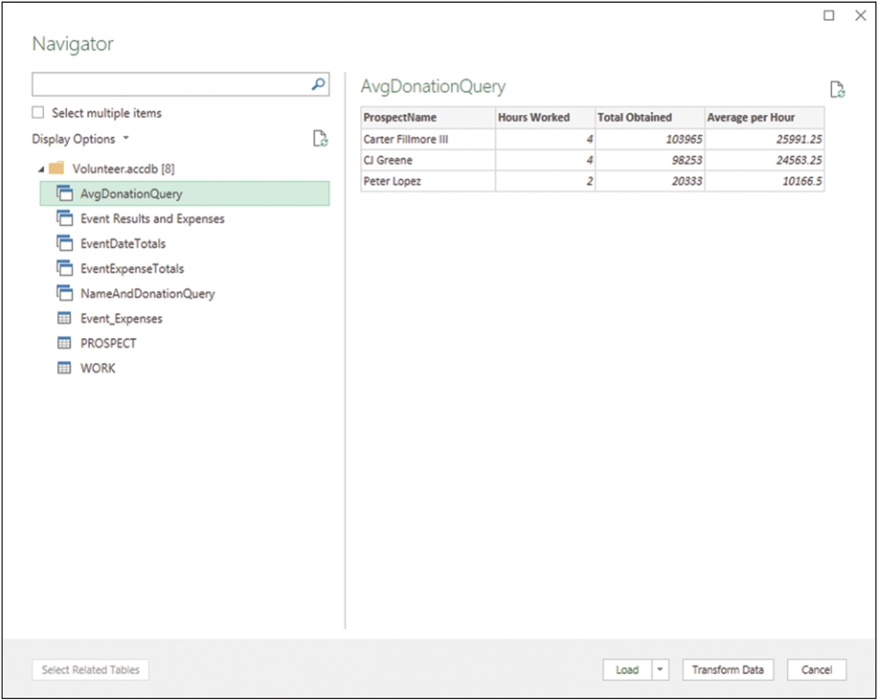
Selecting the Query to Import
CE 8-5 How can you use Excel to graph Access data?
Figure C E 8-21 Selecting the Query to Import
SOURCE: Microsoft Excel 2019

Slide 32
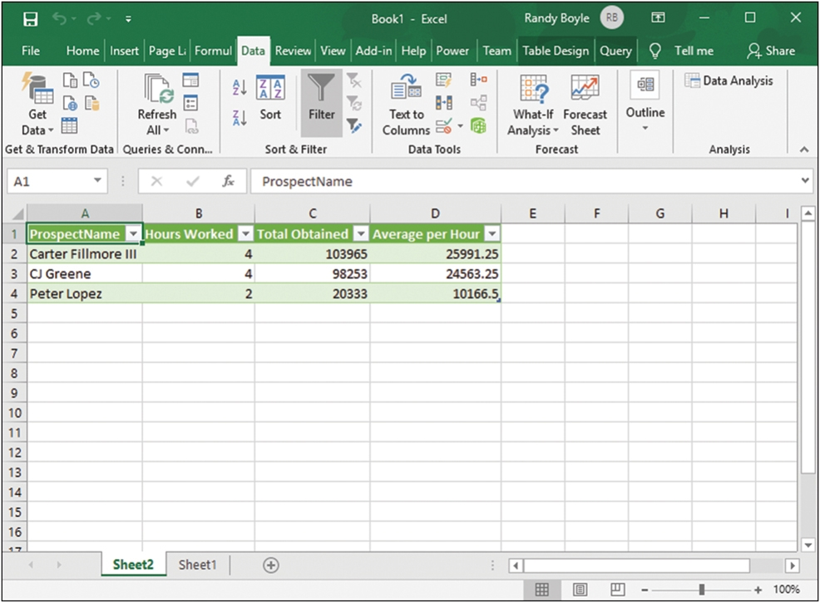
Spreadsheet with Imported Data
CE 8-5 How can you use Excel to graph Access data?
Figure C E 8-22 Spreadsheet with Imported Data
SOURCE: Microsoft Excel 2019

Slide 33
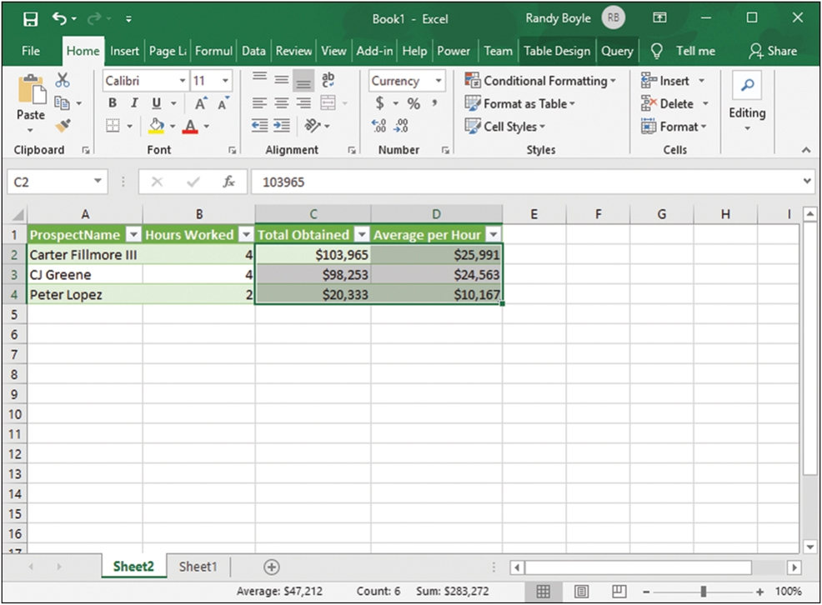
Formatted Imported Data
CE 8-5 How can you use Excel to graph Access data?
Figure C E 8-23 Formatted Imported Data
SOURCE: Microsoft Excel 2019
Notes:
Notice that Excel does not format the currency values as currency. To overcome this deficiency, highlight the cells containing the currency amounts and click Currency in the Number section of the Home ribbon. Next, click the small arrow in the bottom-right corner of the Number section, and select zero decimal points.

Slide 34
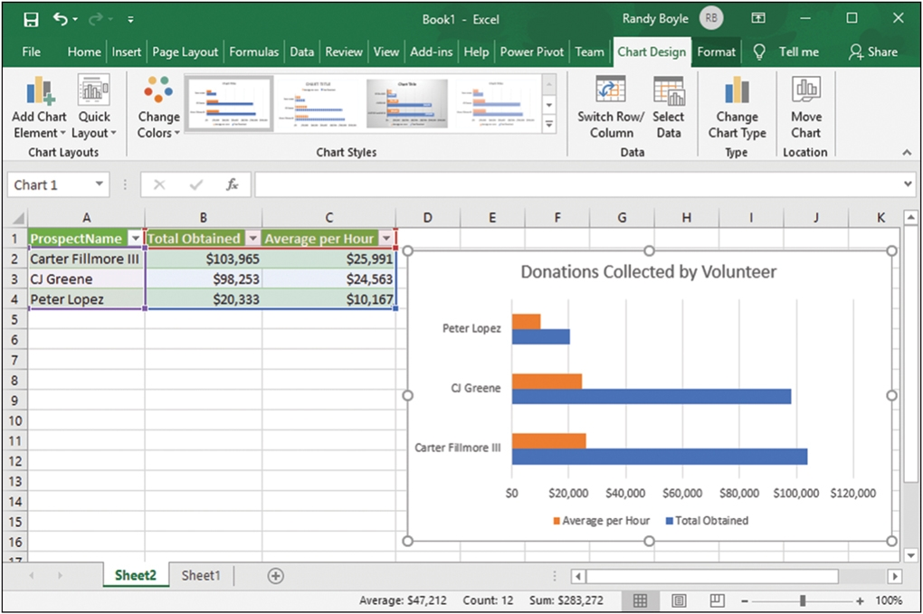
Bar Chart of the Imported Data
CE 8-5 How can you use Excel to graph Access data?
Figure C E 8-24 A Bar Chart of the Imported Data
SOURCE: Microsoft Excel 2019

Slide 35
Reflect on What We Have Done
CE 8-5 How can you use Excel to graph Access data?
Used Access to keep track of volunteers and their received donations, to query and group data—all tasks for which Access is ideally suited.
Imported data into Excel and used Excel’s easy graphing capability to create charts.

Slide 36
Producing Reports from This Data
CE 8-6 How can you use Access to report Excel data?
Produce two different reports from this data.
Group all expenses for a given expense category to produce an expense total.
Group all expenses for particular dates to produce an expense total for each date.
Do both by importing Excel data into Access and using Access report generator.

Slide 37
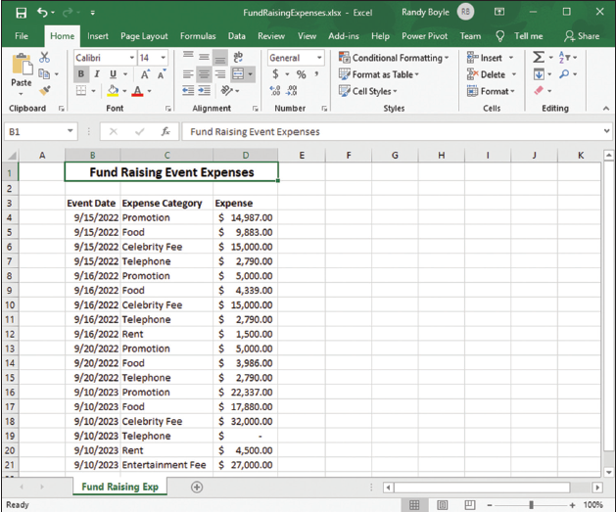
Sample Expense Data
CE 8-6 How can you use Access to report Excel data?
Figure C E 8-25 Sample Expense Data
SOURCE: Microsoft Excel 2019

Slide 38
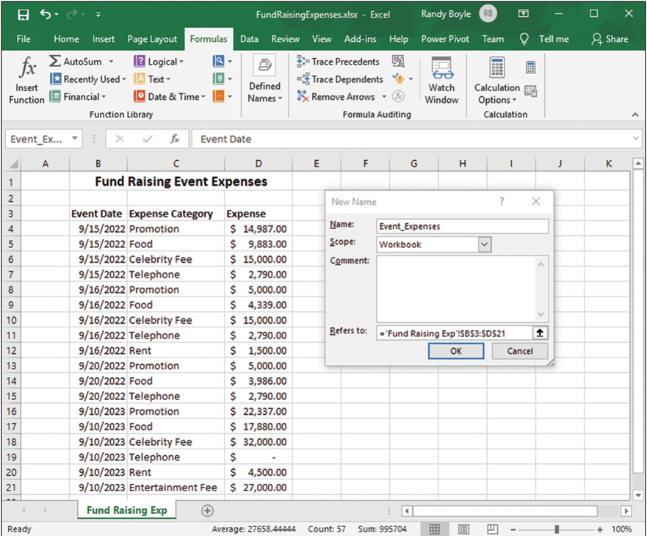
Creating a Named Range in Excel
CE 8-6 How can you use Access to report Excel data?
Figure C E 8-26 Creating a Named Range
SOURCE: Microsoft Excel 2019
Notes:
Identify the data that you want to transfer. An easy way to do this is to create a named range, which is a subset of the cells in a worksheet that has a unique name.

Slide 39
Creating a Named Range in Excel (con’t.)
CE 8-6 How can you use Access to report Excel data?
Highlight data (including column headings) and
click Formulas tab
In Defined Names section,
click Define Name and enter a suitable name
Note: Range names cannot have any spaces, so use underscores
Notes:
Highlight all of data (including column headings), then click Formulas tab. In Define Names section, click Define Name and enter a suitable name.

Slide 40
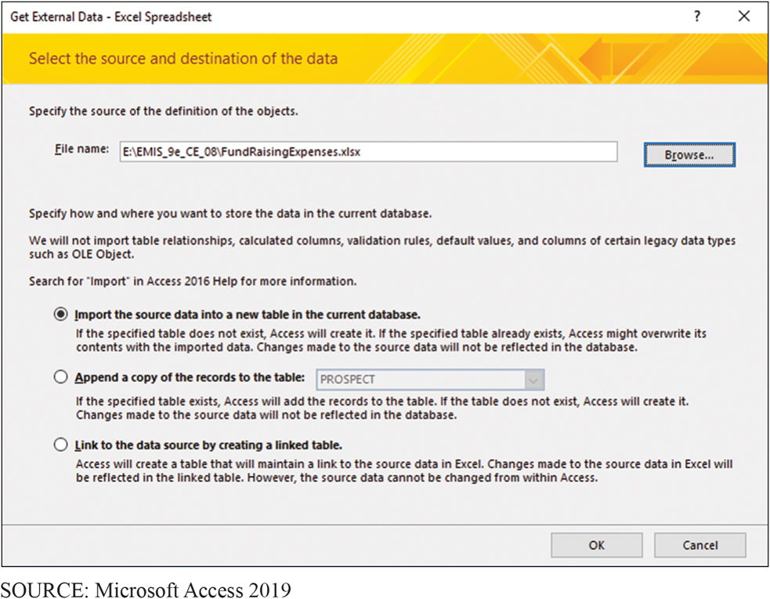
Importing an Excel File into Access
CE 8-6 How can you use Access to report Excel data?
Figure C E 8-27 Importing an Excel File
Notes:
Open the Access database into which you want to import the data, click the External Data tab, and, in the Import & Link section, click New Data Source, From File, and Excel. In the screen that appears, select the spreadsheet that has the data and click Import the source data into a new table in the current database, as shown in Figure CE8-27. Click OK to continue.

Slide 41
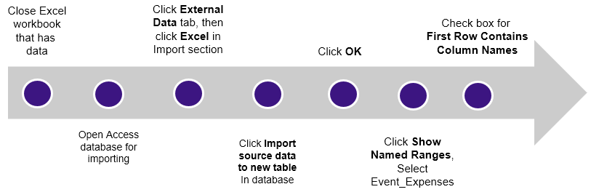
Importing Data in Named Range into a New Access Table
CE 8-6 How can you use Access to report Excel data?
Notes:
These steps are performed in sequence as numbered.

Slide 42
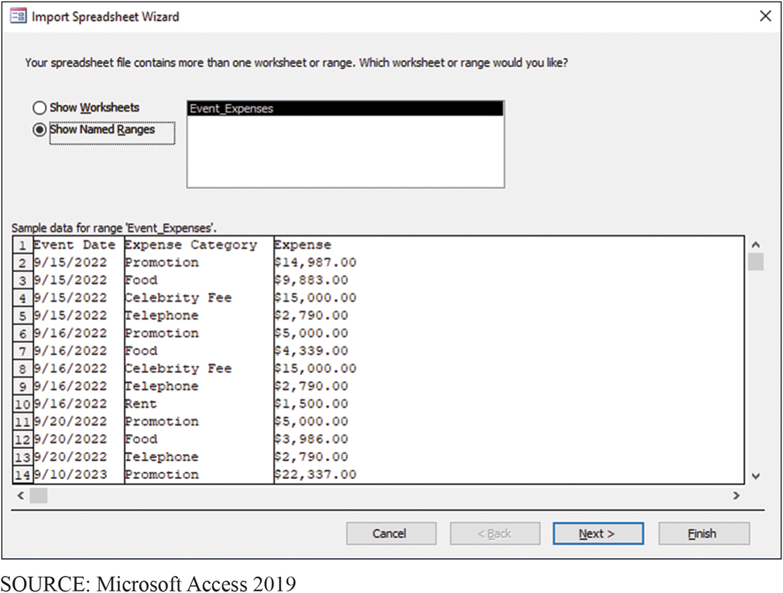
Importing an Excel File
CE 8-6 How can you use Access to report Excel data?
Figure C E 8-28a Importing Excel data into Access: Importing the data in the named range

Slide 43
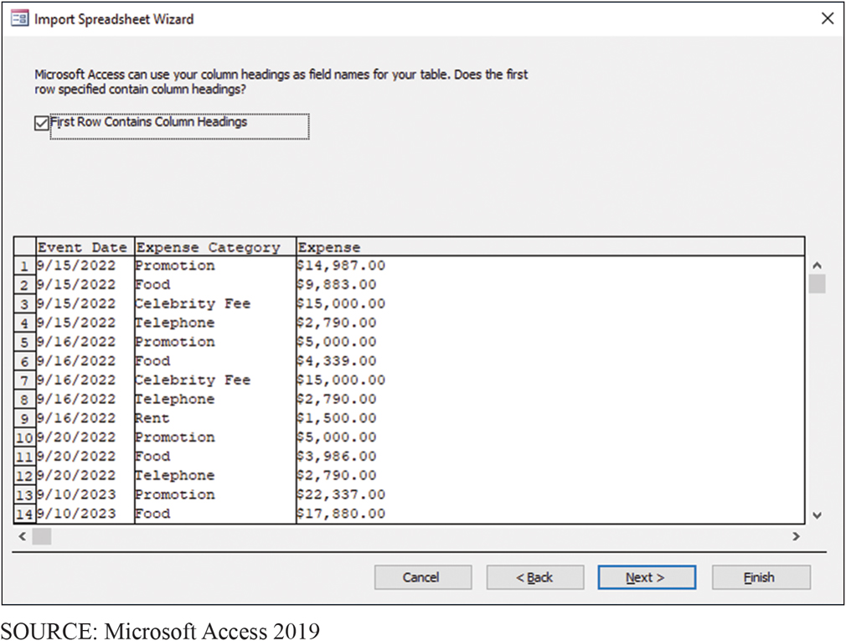
Access Has Metadata to Guide Import
CE 8-6 How can you use Access to report Excel data?
Figure C E 8-28b Importing Excel Data into Access: Access Has Metadata to Guide Import

Slide 44
Creating Expense Reports
CE 8-6 How can you use Access to report Excel data?
After clicking Finish, Access creates table with metadata descriptions and places data into Event_Expenses table
Open Event_Expenses table
Click Create, click Report in Reports section
Access generates report to modify to desired format
Select Design View from View grouping
Deselect everything

Slide 45
Steps to Combine Excel and Access to Analyze Data?
CE 8-6 How can you use Access to report Excel data?
Click ID in Page header. Press Delete
Click ID in Detail section. Press Delete
Click Add a group, then click Expense Category, shown in next slide
Click More and click Expense totaled
Select Total On Expense, Show Grand Total, and Show subtotal in group footer
Report finished

Slide 46
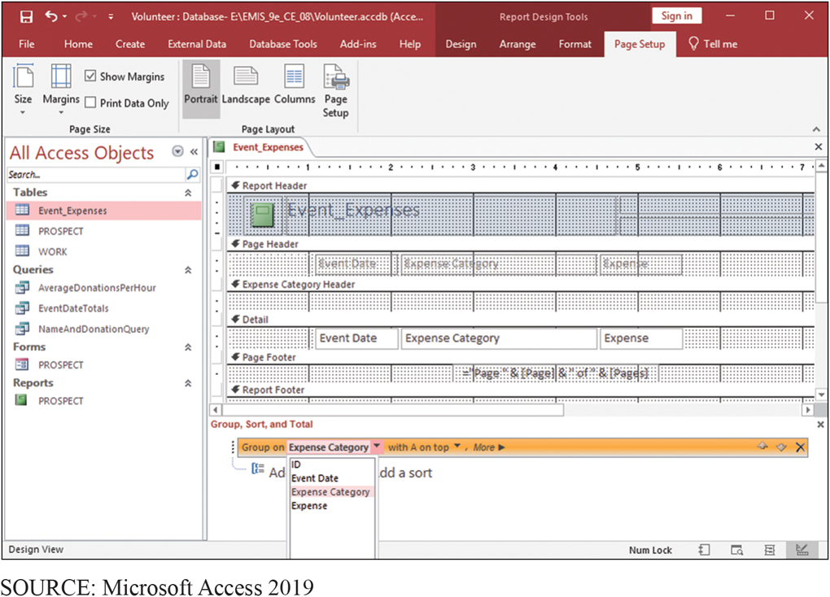
Grouping Report Data by Expense Category
CE 8-6 How can you use Access to report Excel data?
Figure C E 8-29 Grouping Report Data by Expense Category

Slide 47
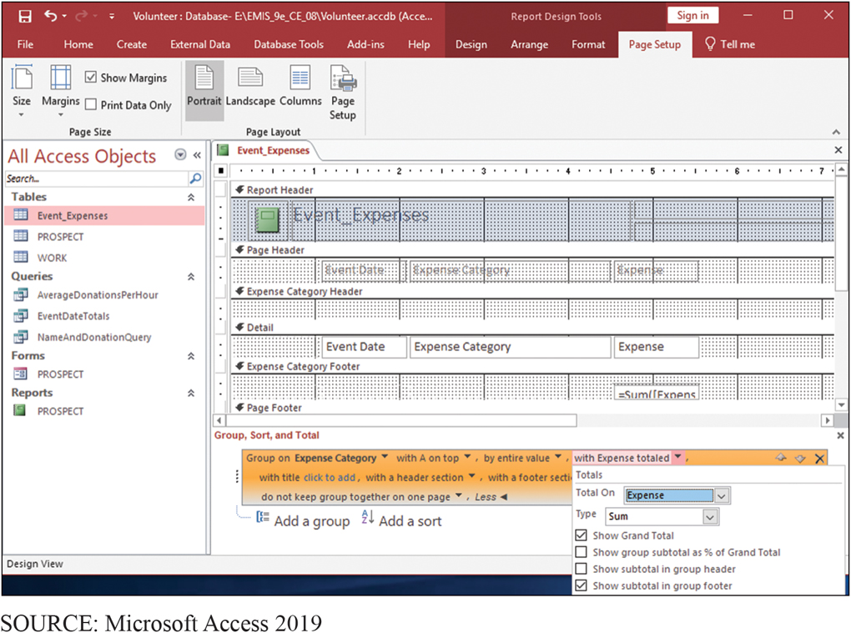
Creating Group Totals
CE 8-6 How can you use Access to report Excel data?
Figure C E 8-30 Creating Group Totals

Slide 48
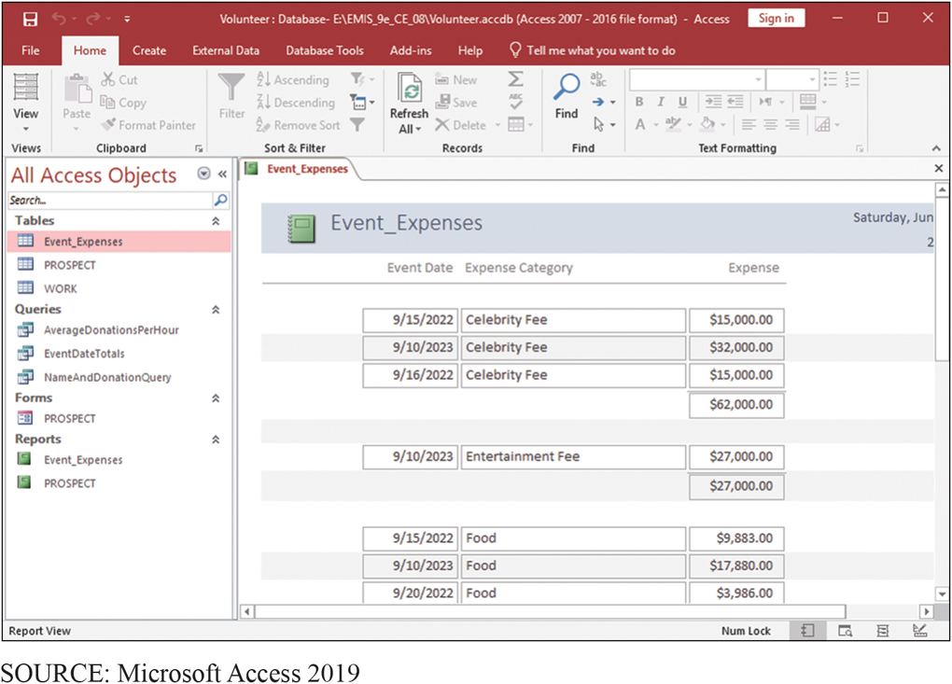
Resulting Report
CE 8-6 How can you use Access to report Excel data?
Figure C E 8-31 Resulting Report

Slide 49
Create Event Expense Totals Query
CE 8-7 How can you combine Excel and Access to analyze data?
Open database containing Event_Expenses data.
In the Queries grouping, click CREATE/Query Design
Click Event_Expenses. Click Close
Add Event Date field and Expense to query
Click Totals to create the Total row in the query grid
Select Group By under Event Date; select Sum under Expense
Enter heading Total Event Expense for the Event Expense column
Save query named as EventExpenseTotals

Slide 50
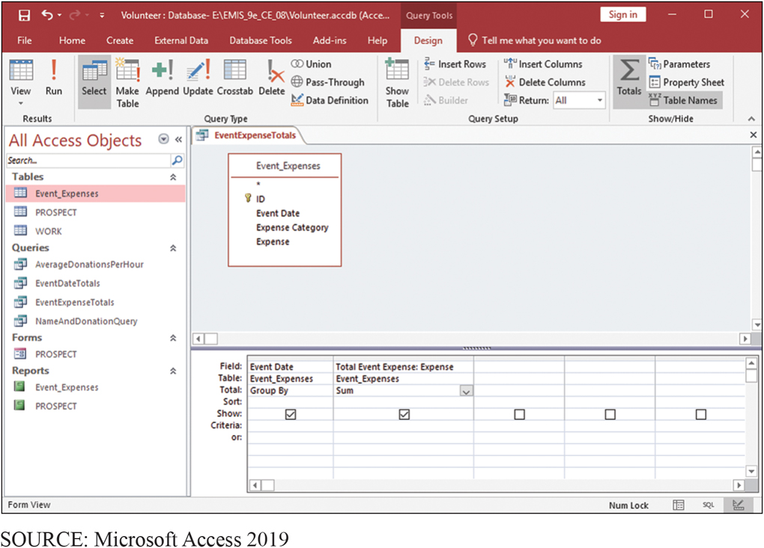
Query to Sum Expenses by Date
CE 8-7 How can you combine Excel and Access to analyze data?
Figure C E 8-32 Creating a Query to Sum Expenses by Date

Slide 51
Creating a Query to Combine Results of Two Other Queries
CE 8-7 How can you combine Excel and Access to analyze data?
Merge Event Date Totals query with EventExpenseTotals query
Click Create/Query Design, then Queries tab in Show Table window, as shown in next slide
Add both EventDateTotals and Event Expense Totals to query
Drag Date field in Event Date Totals and drop on top of Event Date in EventExpenseTotals query
Add Date, Sum Of Total Donation, and Total Event Expense to query
Run (!) query
Save query as Event Results and Expenses

Slide 52
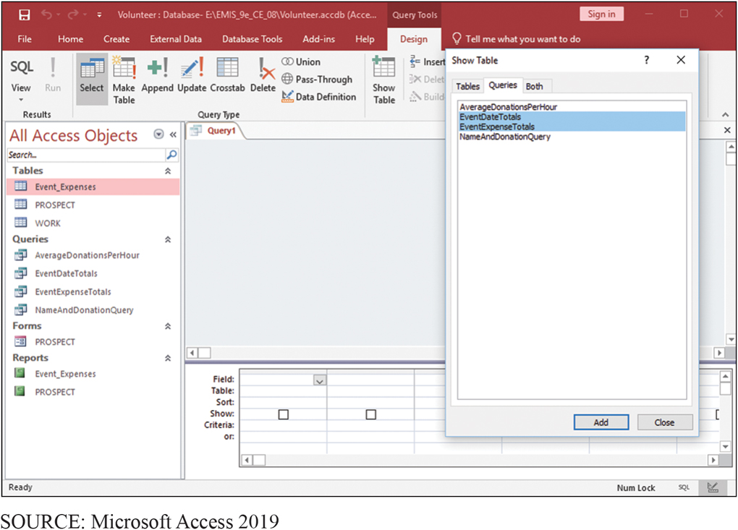
Combining the Results of Two Queries
CE 8-7 How can you combine Excel and Access to analyze data?
Figure C E 8-33 Combining the Results of Two Queries
Notes:
Click Create/Query Design; click Queries tab in Show Table window. Add both EventDateTotals and EventExpenseTotals to query.

Slide 53
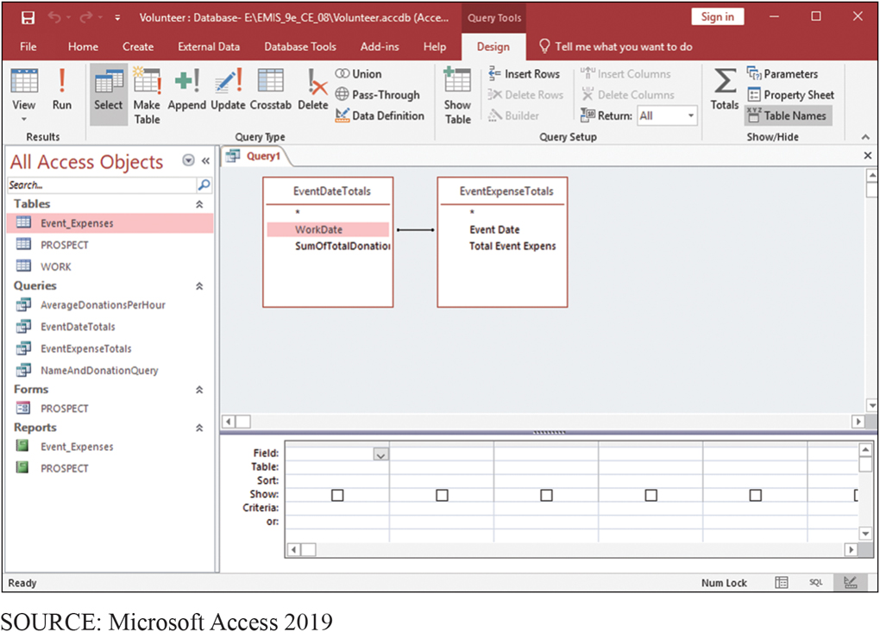
Matching Data Values in the Two Queries
CE 8-7 How can you combine Excel and Access to analyze data?
Figure C E 8-34 Matching Date Values in the Two Queries
Notes:
Inform Access that Date values in two queries are the same by dragging Date field in EventDateTotals and dropping it on Event Date in EventExpenseTotals query.

Slide 54
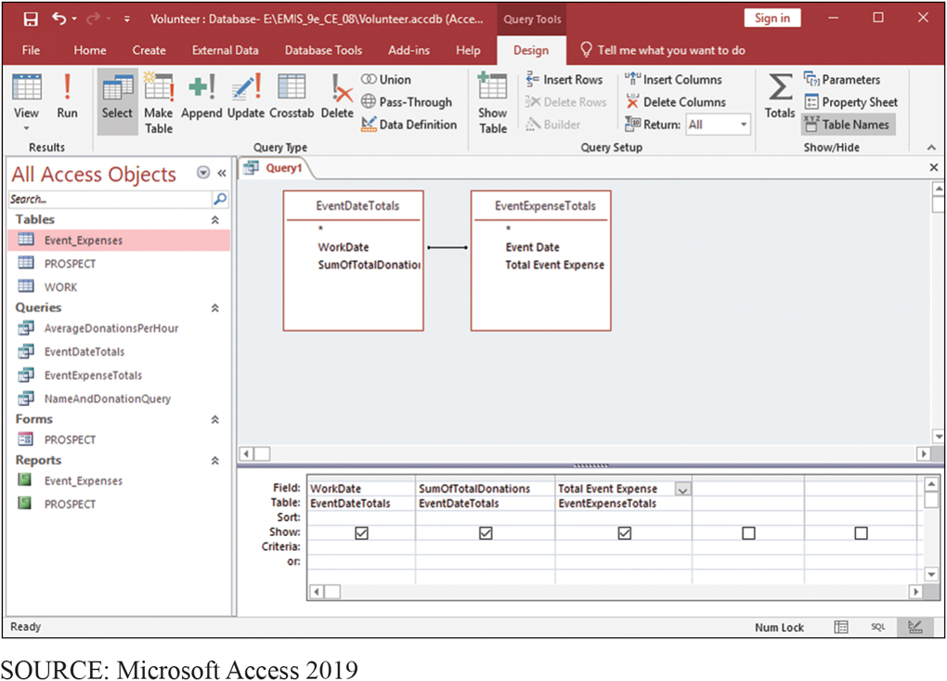
Query with Columns Added
CE 8-7 How can you combine Excel and Access to analyze data?
Figure C E 8-35 Query with Columns Added

Slide 55
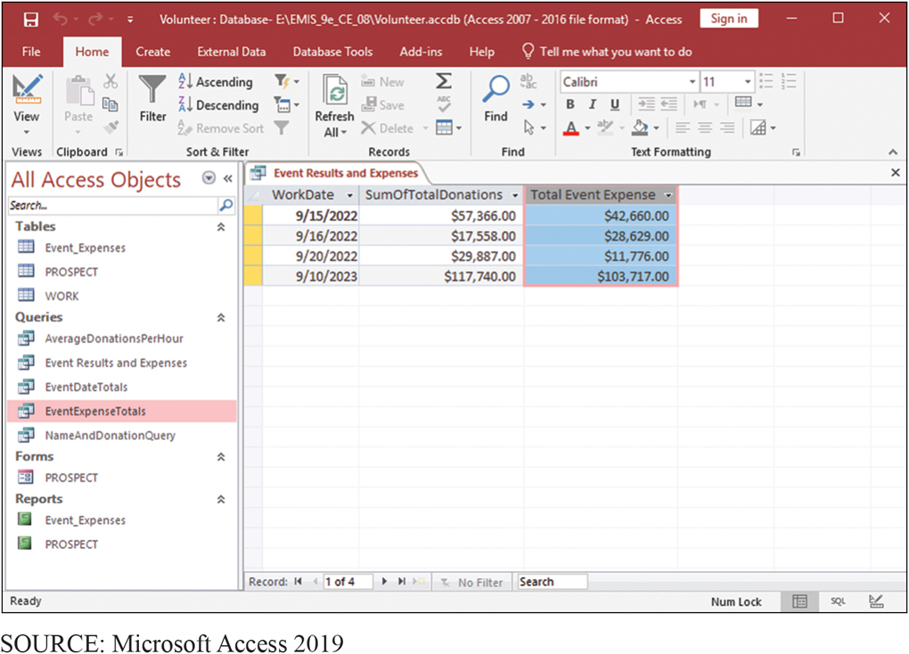
Results of Query in Figure
CE 8-7 How can you combine Excel and Access to analyze data?
Figure C E 8-36 Result of Query in Figure C E 8-35

Slide 56
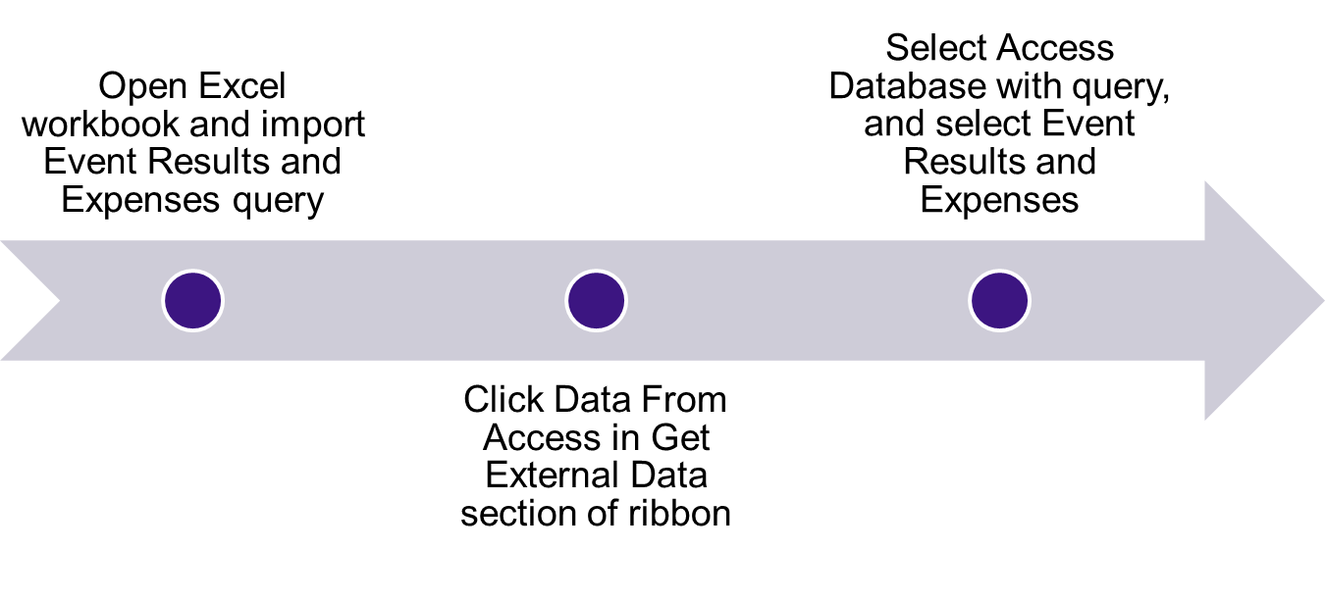
Import Events Results and Expenses into Excel
CE 8-7 How can you combine Excel and Access to analyze data?

Slide 57
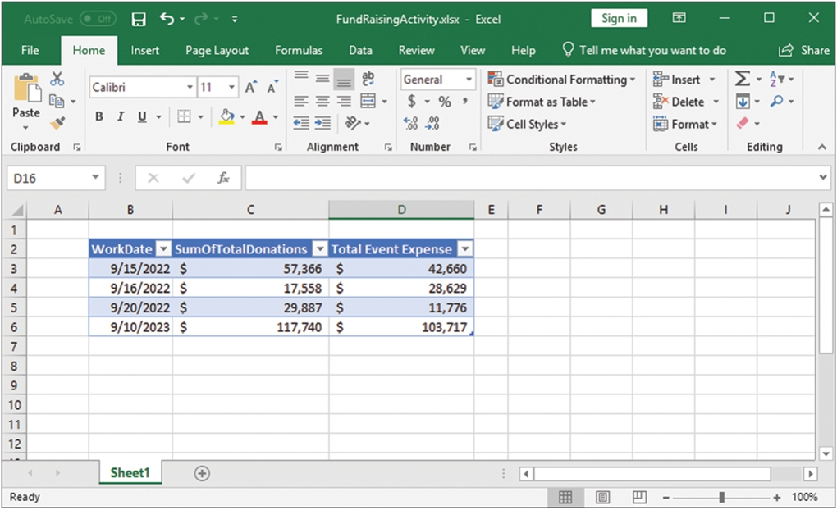
Query in Figure Imported into Excel
CE 8-7 How can you combine Excel and Access to analyze data?
Figure C E 8-37 Query in Figure C E 8-35 Imported to Excel
SOURCE: Microsoft Excel 2019

Slide 58
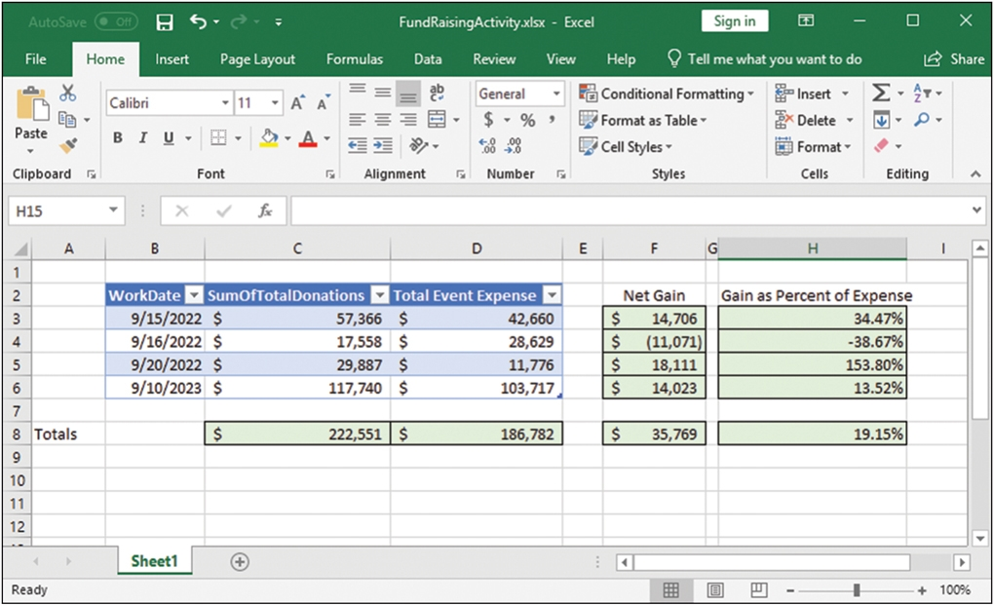
Imported into Excel
CE 8-7 How can you combine Excel and Access to analyze data?
Figure C E 8-38 Imported to Excel
SOURCE: Microsoft Excel 2019
Notes:
Expense data began as Excel data in Fund Raising Expense worksheet, then imported into Access, where it was summed. Results of Total Event Expense query were imported back to Excel.
Here, the user computed Net Gain, Net Gain as a Percent of Expense, and Totals for donations and expenses.

Slide 59
Reflect on What Has Been Done with This Data
CE 8-7 How can you combine Excel and Access to analyze data?
Total Donation data originated in Access and summed using an Access query
Expense data from Excel worksheet Fund Raising Expense imported into Access, and summed in a query
Results of Total Event Expense query imported back to Excel, and analyzed

Slide 60
Active Review
CE 8-1 Why use Excel and Access together?
CE 8-2 What is import/export?
CE 8-3 How can you create charts with Excel?
CE 8-4 How can you create group totals in Access?
CE 8-5 How can you use Excel to graph Access data?
CE 8-6 How can you use Access to report Excel data?
CE 8-7 How can you combine Excel and Access to analyze data?

Slide 61

Copyright

